Slide 1


Comparative Study of Blockchain Mining
G-36
Riya Mudgal
Supervisor : Prof. (Dr.) Arun Kumar Tripathi
Co-Supervisor Apoorv Jain sir(BlochChain Developer)

Slide 2
Blockchain

Slide 3
What exactly is blockchain ?
Blockchain is a system of recording information in a way that makes it difficult or impossible to change, hack, or cheat the system.
Blockchain can be described as a data structure that holds transactional records and while ensuring security, transparency, and decentralization
The data on a Blockchain is unable to be modified, which makes it a legitimate disruptor for industries like payments, cybersecurity and healthcare

Slide 4
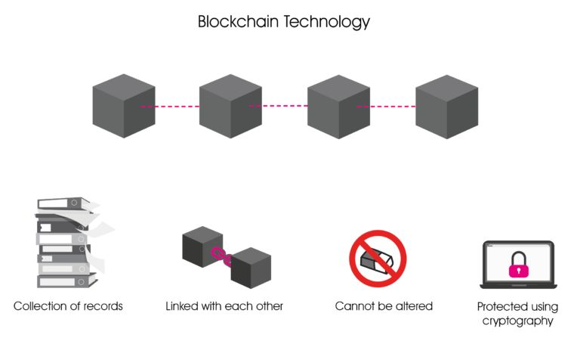
Blockcahin Diagram
A blockchain is a growing list of records, called blocks, that are linked together using cryptography
Each block contains a cryptographic hash of the previous block, a timestamp, and transaction data

Slide 5
Terminology
Block
A block is like a page of a ledger or record book. Each time a block is 'completed', it gives way to the next block in the blockchain
A block is the basic building element of a blockchain which stores records.
Distrubuted LedgerTechnology
Distributed ledger technology (DLT) refers to the technological infrastructure and protocols that allows simultaneous access, validation, and record updating in an immutable manner across a network that's spread across multiple entities or locations. Distributed ledger technology (DLT) is a protocol that enables the secure functioning of a decentralized digital database. Distributed networks eliminate the need for a central authority to keep a check against manipulation

Slide 6
Terminology
Transaction
When a transaction is recorded in the blockchain, details of the transaction such as price, asset, and ownership, are recorded, verified and settled within seconds across all nodes. A verified change registered on any one ledger is also simultaneously registered on all other copies of the ledger.
Consensus Algorithms
A consensus algorithm is a procedure through which all the peers of the blockchain network reach a common agreement about the present state of the distributed ledger. The consensus protocol makes sure that every new block that is added to the blockchain is the one and only version of the truth that is agreed upon by all the nodes in the blockchain.

Slide 7
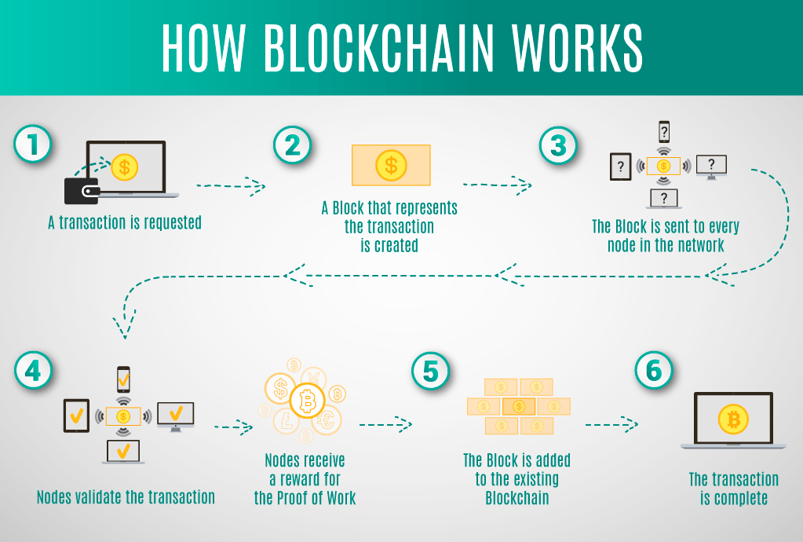
Working of Blockchain

Slide 8
Effective Applications
Money transfer and payment processing
Food safety
Unchangeable data backup
Digital voting
Protection of royalty and copyright
dApps
Cryptocurrency

Slide 9
Consensus Algorithms
It is a procedure via which all the peers of a blockchain network reach a common acceptance or consensus about the real-time state of the distributed ledger.
A consensus mechanism enables the blockchain network to attain reliability and build a level of trust between different nodes, while ensuring security in the environment.

Slide 10
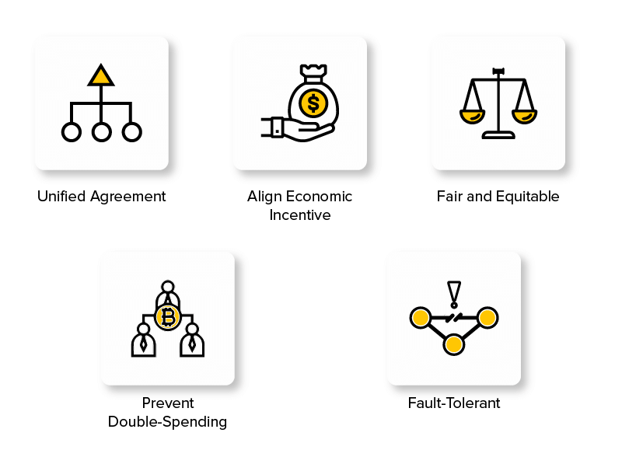
Objectives of Blockchain Consensus Mechanisms

Slide 11
Objectives
1 Unified agreement
One of the prime objectives of consensus mechanisms is attaining unified agreement.
Unlike centralized systems where having a trust on authority is necessary, users can operate even without building trust in each other in a decentralized manner. The protocols embedded in the distributed blockchain network ensures that the data involved in the process is true and accurate, and the status of the public ledger is up-to-date.

Slide 12
Objectives
2. Align economic incentive
When it comes to building a trustless system that regulates on its own, aligning the interests of participants in the network is a must.
A consensus blockchain protocol, in this situation, offers rewards for good behavior and punishes the bad actors. This way, it ensures regulating economic incentives too

Slide 13
Objectives
3. Fair & Equitable
Consensus mechanisms enable anyone to participate in the network and use the same basics. This way, it justifies the open-source and decentralization property of the blockchain system.
4. Prevent double spending
Consensus mechanisms works on the basis of certain algorithms that ensures that only those transactions are included in the public transparent ledger which are verified and valid. This solves the traditional problem of double-spending, i.e, the problem of spending a digital currency twice.

Slide 14
Objectives
5. Fault tolerant
Another characteristic of the consensus method is that it ensures that the blockchain is fault-tolerant, consistent, and reliable. That means, the governed system would work indefinite times even in the case of failures and threats.

Slide 15
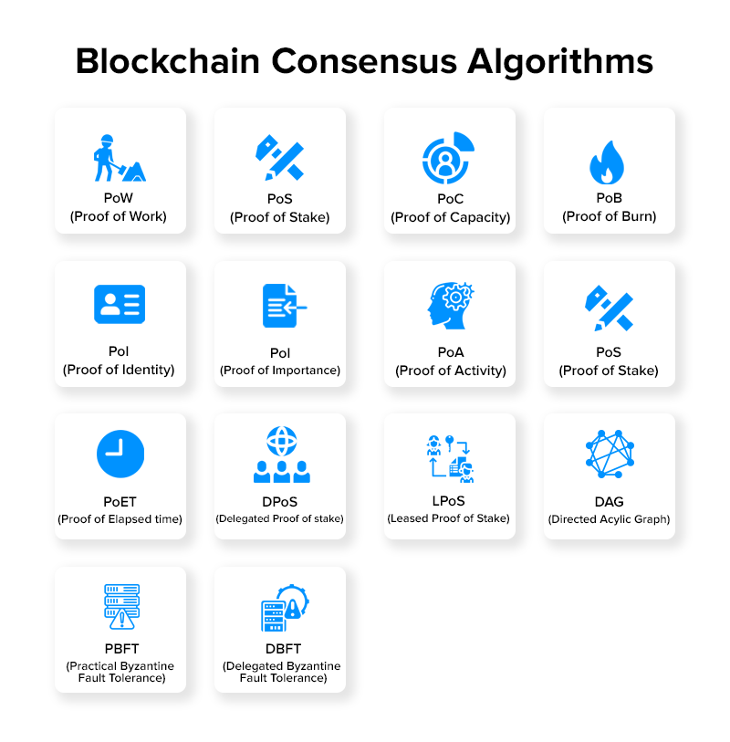
BlockCHAIN CONSENSUS ALGORTITHMS

Slide 16
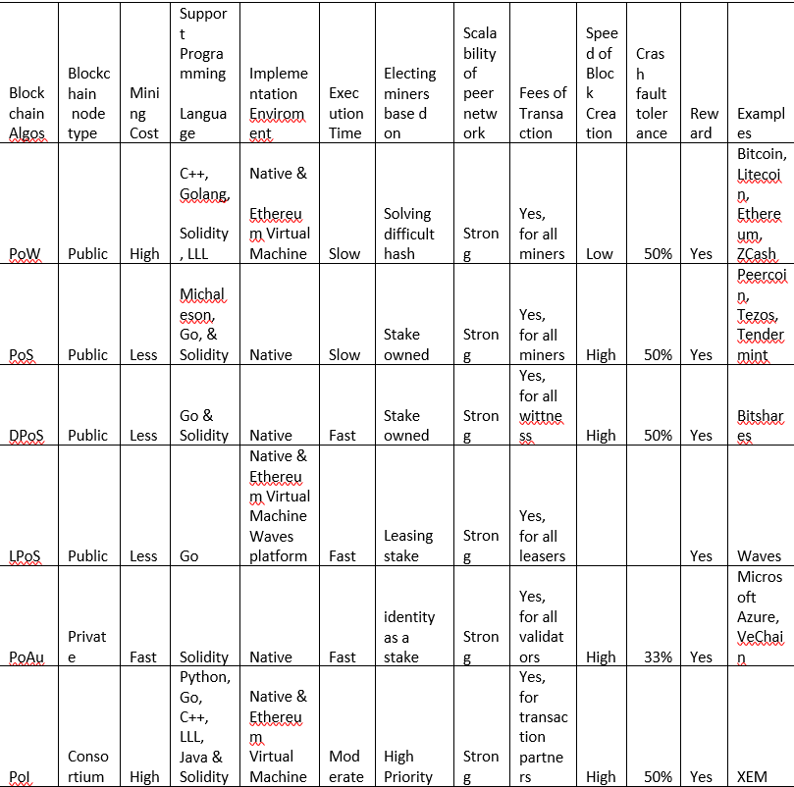
Comparative STUDY OF SOME CONSENSUS ALGOS

Slide 17
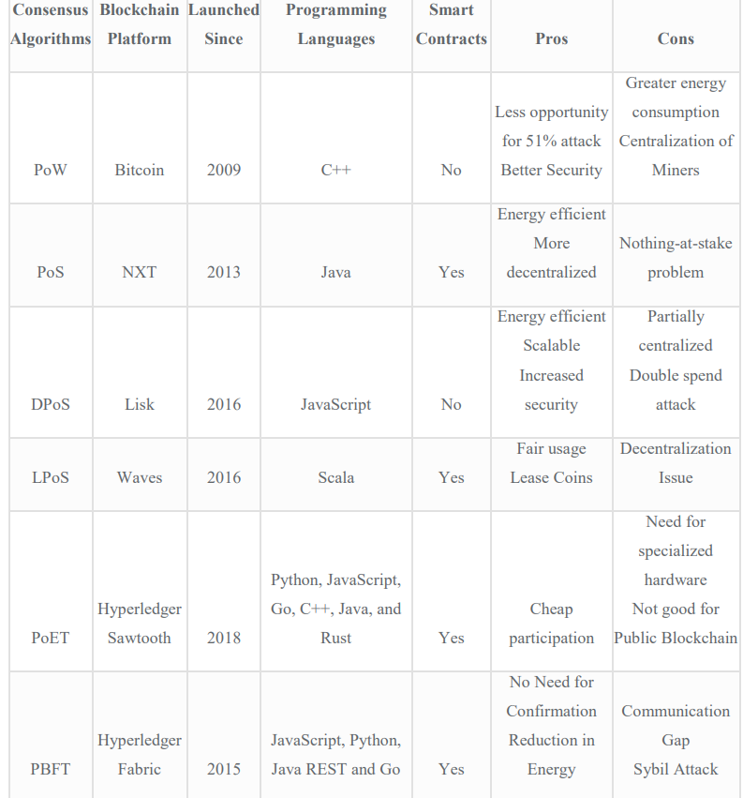
Comparative STUDY OF SOME CONSENSUS ALGOS

Slide 18
Consensus Algorithms
1. Proof of work
In this mechanism, the miners have to solve complex mathematical puzzles using comprehensive computation power. They use different forms of mining methods, such as GPU mining, CPU mining, ASIC mining, and FPGA mining. And the one that solves the problem at the earliest gets a block as a reward.
2. Proof of stake
Proof of stake is the most basic and environmentally-friendly alternative of pow consensus protocol.
In this blockchain method, the block producers are not miners, but they act like validators. They get the opportunity to create a block over everyone which saves energy and reduces the time. However, for them to become a validator, they are supposed to invest some amount of money or stake.

Slide 19
Consensus Algorithms
Delegated Proof of Stake (DPoS)
In the case of delegated proof of stake (dpos), the participants stake their coin and vote for a certain number of delegates such that the more they invest, the more weightage they receive. The delegates also get rewarded in the form of transaction fees or a certain amount of coins. Stake-weighted voting mechanism
Leased proof of work(LPOS)
Unlike the regular proof-of-stake method where each node with some amount of cryptocurrency is entitled to add the next blockchain, users can lease their balance to full nodes in this consensus algorithm blockchain. And the one that leases the bigger amount to the full node has a higher probability of generating the next block

Slide 20
Consensus Algorithms
3. Proof of authority
Proof of authority is a modified version of proof of stake in which the identities of validators in the network are at stake. In this, to verify the validator’s identity, the identity is the resemblance between validators’ personal identification and their official documentation. These validators put their reputation on the network.
4. Byzantine fault tolerance (BFT)
Byzantine fault tolerance, as the name suggests, is used to deal with byzantine fault (also called byzantine generals problem) – a situation where the system’s actors have to agree on an effective strategy so as to circumvent catastrophic failure of the system, but some of them are dubious.
The two variations of the BFT consensus model that are prime in the blockchain arena are PBFT and DBFT.

Slide 21
Consensus Algorithms
6. Proof of Capacity (PoC)
In the proof of capacity (poc) mechanism, solutions for every complex mathematical puzzle are accumulated in digital storages like hard disks. Users can use these hard disks to produce blocks, in a way that those who are fastest in evaluating the solutions get better chances for creating blocks.

Slide 22
Consensus Algorithms
5. Proof of Activity
PoA is basically a hybrid approach designed through the convergence of PoW and PoS blockchain consensus models.
In the case of poA mechanism, miners race to solve a cryptographic puzzle at the earliest using special hardware and electric energy, just like in pow. However, the blocks they come across hold only the information about the identity of the block winner and reward transaction. This is where the mechanism switches to pos.
The validators (shareholders appointed to validate transactions) test and ensure the correctness of the block. If the block was checked many times, the validators activate to a complete block. This confirms that open transactions are processes and are finally integrated into the found block containers.

Slide 23
Properties of Consensus Algorithms
1. Safety
In a good consensus mechanism, all the nodes are capable of generating results that are valid according to the rules of protocol.
2. Inclusive
A good consensus blockchain mechanism ensures that every particular node of the network participates in the process of voting.
3. Participatory
A consensus mechanism where all the nodes actively participate and contribute to updating databases on blockchain is called a good consensus model.
4. Egalitarian
Another trait of a good mechanism is that it gives equal value and weightage to every vote received from the node.
With this in mind, let’s find out what happens when you do not consider these factors and introduce a poor consensus model to your development process.

Slide 24
References
1. https://en.wikipedia.org/wiki/Ledger
2. https://en.bitcoin.it/wiki/Block
3. https://en.bitcoin.it/wiki/Genesis_block
4. https://en.wikipedia.org/wiki/Digital_currency
5. Mingxiao, D., Xiaofeng, M., Zhe, Z., Xiangwei,W., Qijun, C.: A review on consensus algorithm of blockchain. In 2017 IEEE International Conference on Systems, Man, and Cybernetics (SMC), pp. 2567–2572. IEEE (2017)
6. Norman, M.D., Karavas, Y.G., Reed, H.: The emergence of trust and value in public blockchain networks. In: IX International Conference on Complex Systems, p. 22 (2018)
7. Public Vs. Private Blockchain : A Comprehensive Comparison (blockchain-council.org)

Slide 25
OUTCOME
My paper is completed and is about to get published soon

Slide 26
Thank you

